Slide 1
KTK8’s mini hen quiz
Shamelessly ripped off from Only Connect

Slide 2






Menu Round 2

Slide 3

Horned Viper
Menu Round 2

Slide 4
Water
Menu Round 2

Slide 5
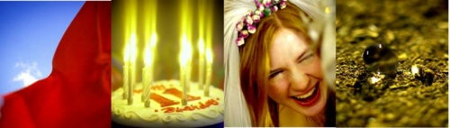
Eye of Horus
Menu

Slide 6
Two Reeds
PP
P
MP
MF
Menu

Slide 7
Lion
Denis
Norma
Cherie
Sarah
Menu

Slide 8
Twisted Flax
Menu Round 2

